Slide 1


Data-Intensive Distributed Computing
CS 451/651 431/631 (Winter 2018)
Part 9: Real-Time Data Analytics (1/2)
March 27, 2018
Jimmy Lin
David R. Cheriton School of Computer Science
University of Waterloo
These slides are available at http://lintool.github.io/bigdata-2018w/
This work is licensed under a Creative Commons Attribution-Noncommercial-Share Alike 3.0 United States See http://creativecommons.org/licenses/by-nc-sa/3.0/us/ for details

Slide 2

users
Frontend
Backend
OLTP database
ETL (Extract, Transform, and Load)
Data Warehouse
My data is a
day old…
BI tools
Meh.
analysts

Slide 3
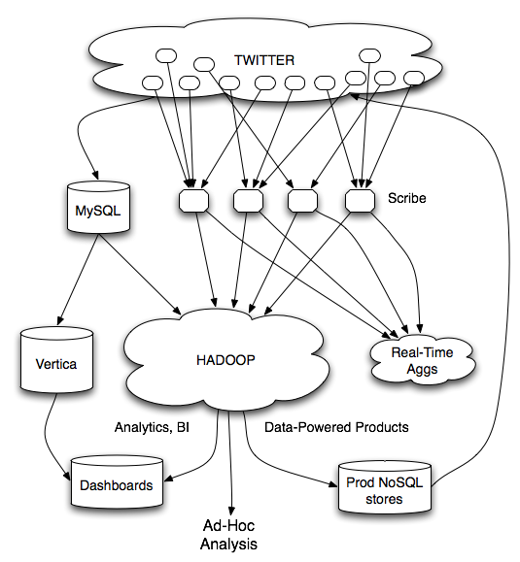
Twitter’s data warehousing architecture

Slide 4
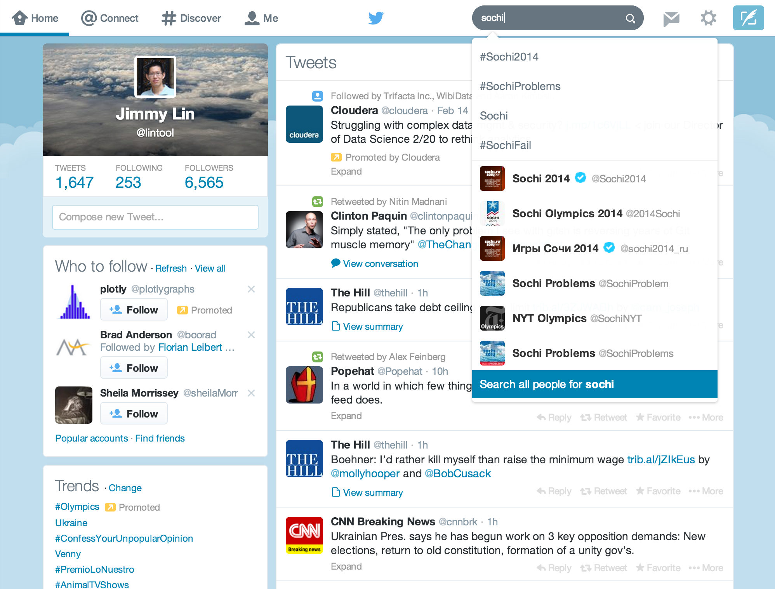
Mishne et al. Fast Data in the Era of Big Data: Twitter's Real-Time Related Query Suggestion Architecture. SIGMOD 2013.

Slide 5
Case Study: Steve Jobs passes away

Slide 6
Initial Implementation
Algorithm: Co-occurrences within query sessions
Implementation: Pig scripts over query logs on HDFS
Problem: Query suggestions were several hours old!
Why?
Log collection lag
Hadoop scheduling lag
Hadoop job latencies
We need real-time processing!

Slide 7
Solution?
Can we do better than one-off custom systems?

Slide 8
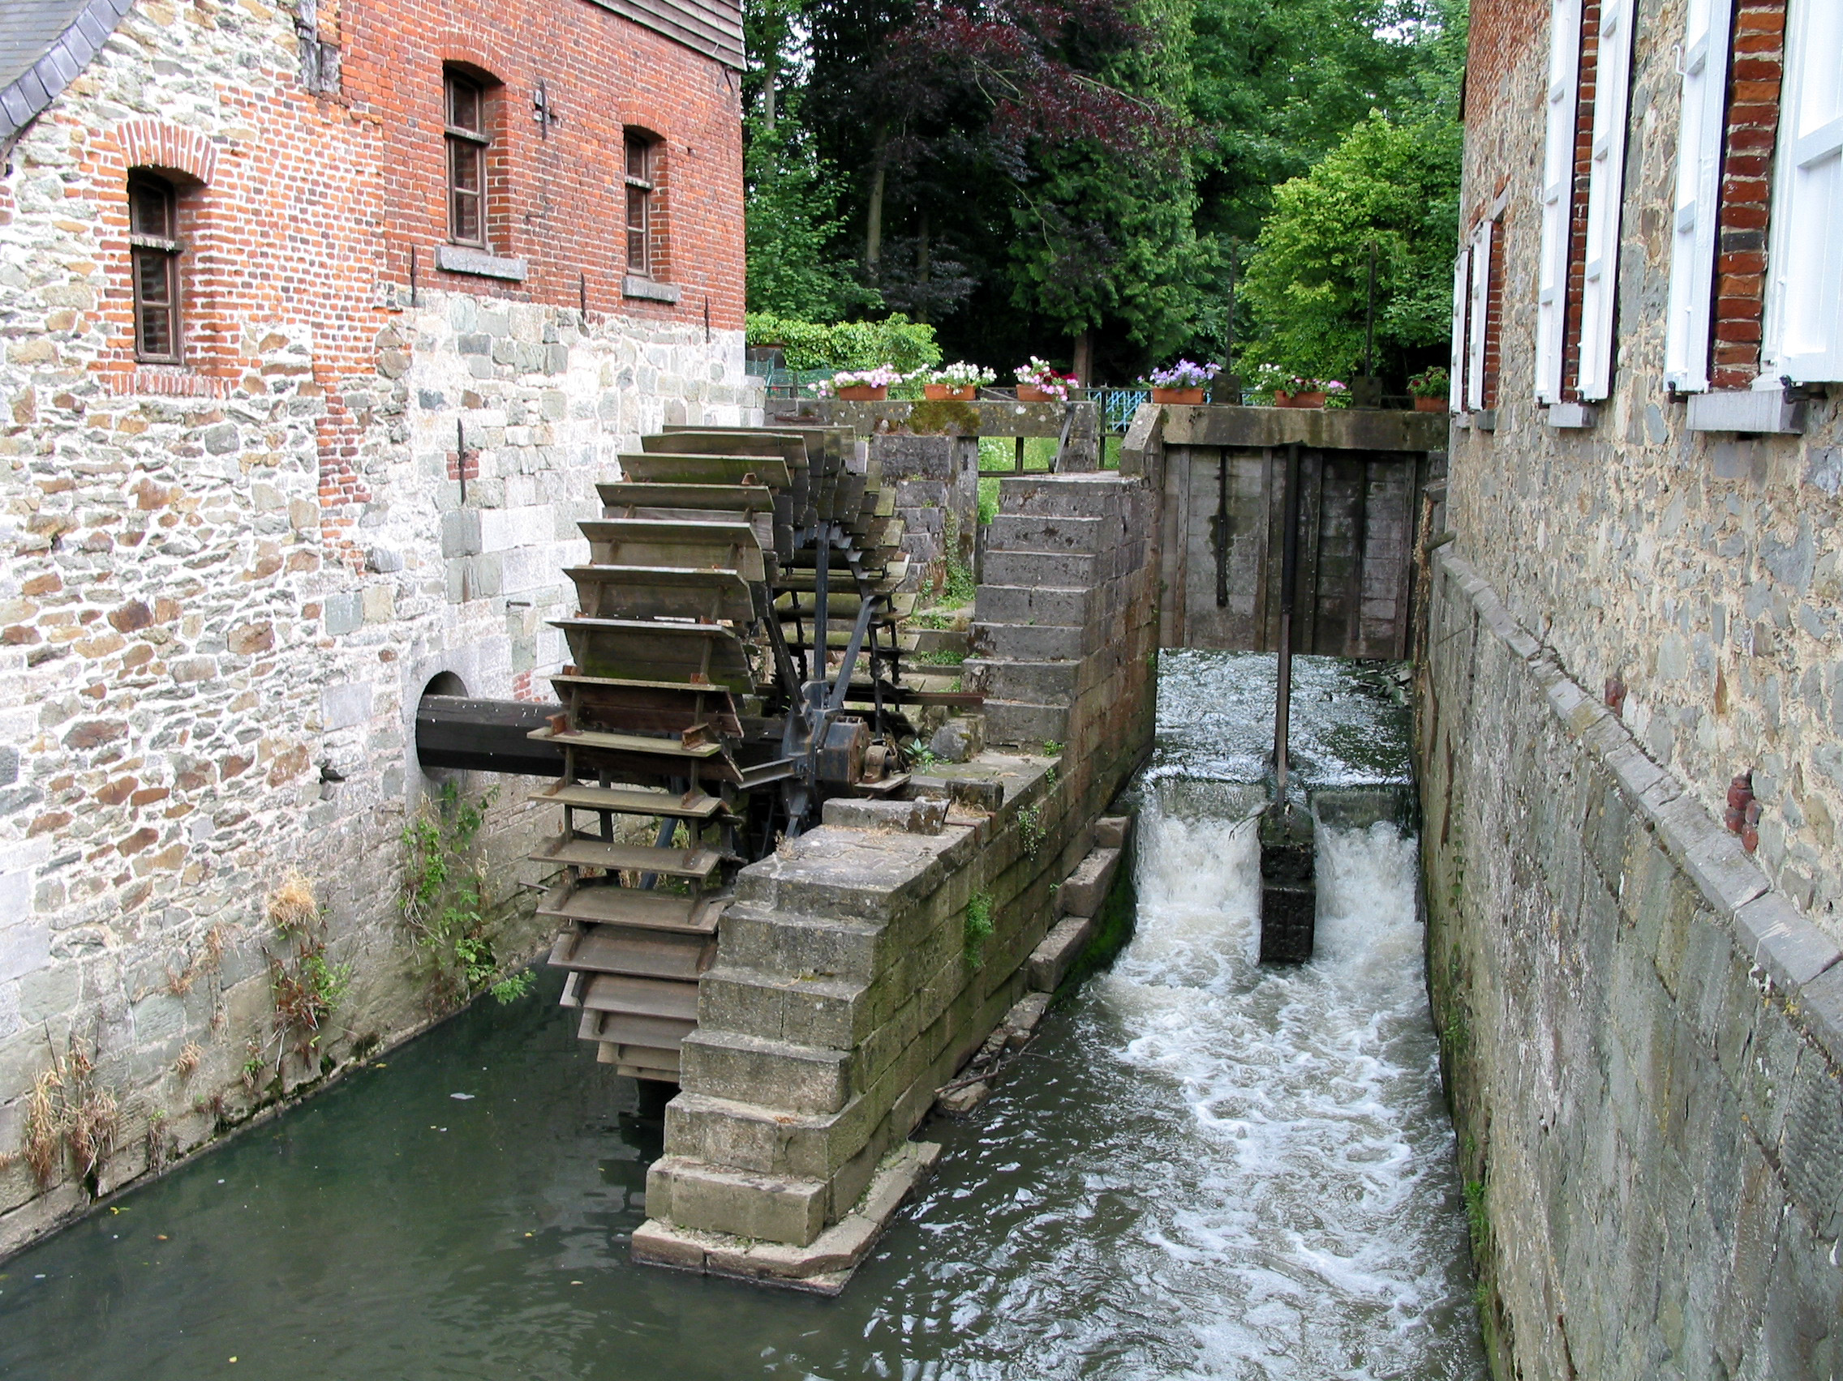
Stream Processing Frameworks
Source: Wikipedia (River)

Slide 9
real-time
vs.
online
vs.
streaming

Slide 10
What is a data stream?
Sequence of items:
Structured (e.g., tuples)
Ordered (implicitly or timestamped)
Arriving continuously at high volumes
Sometimes not possible to store entirely
Sometimes not possible to even examine all items

Slide 11
Applications
Network traffic monitoring
Datacenter telemetry monitoring
Sensor networks monitoring
Credit card fraud detection
Stock market analysis
Online mining of click streams
Monitoring social media streams

Slide 12
What exactly do you do?
“Standard” relational operations:
Select
Project
Transform (i.e., apply custom UDF)
Group by
Join
Aggregations
What else do you need to make this “work”?

Slide 13
Issues of Semantics
Group by… aggregate
When do you stop grouping and start aggregating?
Joining a stream and a static source
Simple lookup
Joining two streams
How long do you wait for the join key in the other stream?
Joining two streams, group by and aggregation
When do you stop joining?
What’s the solution?

Slide 14
Windows
Windows restrict processing scope:
Windows based on ordering attributes (e.g., time)
Windows based on item (record) counts
Windows based on explicit markers (e.g., punctuations)

Slide 15
Windows on Ordering Attributes
Assumes the existence of an attribute that
defines the order of stream elements (e.g., time)
Let T be the window size in units of the ordering attribute
t₁
t₂
t₃
t₄
t₁'
t₂’
t₃’
t₄’
sliding window
t_{i}’ – t_{i} = T
t₁
t₂
t₃
tumbling window
t_{i+1} – t_{i} = T

Slide 16
Windows on Counts
Window of size N elements (sliding, tumbling) over the stream
t₁
t₂
t₁'
t₃
t₂’
t₃’
t₄’

Slide 17
Windows from “Punctuations”
Application-inserted “end-of-processing”
Example: stream of actions… “end of user session”
Properties
Advantage: application-controlled semantics
Disadvantage: unpredictable window size (too large or too small)

Slide 18
Streams Processing Challenges
Inherent challenges
Latency requirements
Space bounds
System challenges
Bursty behavior and load balancing
Out-of-order message delivery and non-determinism
Consistency semantics (at most once, exactly once, at least once)

Slide 19
Stream Processing Frameworks
Source: Wikipedia (River)

Slide 20
Producer/Consumers
Producer
Consumer
How do consumers get data from producers?

Slide 21
Producer/Consumers
Producer
Consumer
Producer pushes
e.g., callback

Slide 22
Producer/Consumers
Producer
Consumer
Consumer pulls
e.g., poll, tail

Slide 23
Producer/Consumers
Consumer
Producer
Consumer
Producer
Consumer
Consumer

Slide 24
Producer/Consumers
Consumer
Producer
Kafka
Broker
Consumer
Producer
Consumer
Consumer
Queue, Pub/Sub

Slide 25
Producer/Consumers
Consumer
Producer
Kafka
Broker
Consumer
Producer
Consumer
Consumer

Slide 26
Storm/Heron
Stream Processing Frameworks
Source: Wikipedia (River)

Slide 27
Storm/Heron
Storm: real-time distributed stream processing system
Started at BackType
BackType acquired by Twitter in 2011
Now an Apache project
Heron: API compatible re-implementation of Storm
Introduced by Twitter in 2015
Open-sourced in 2016

Slide 28

Want real-time stream processing?
I got your back.
I’ve got the most intuitive implementation: a computation graph!

Slide 29
Topologies
Storm topologies = “job”
Once started, runs continuously until killed
A topology is a computation graph
Graph contains vertices and edges
Vertices hold processing logic
Directed edges indicate communication between vertices
Processing semantics
At most once: without acknowledgments
At least once: with acknowledgements

Slide 30
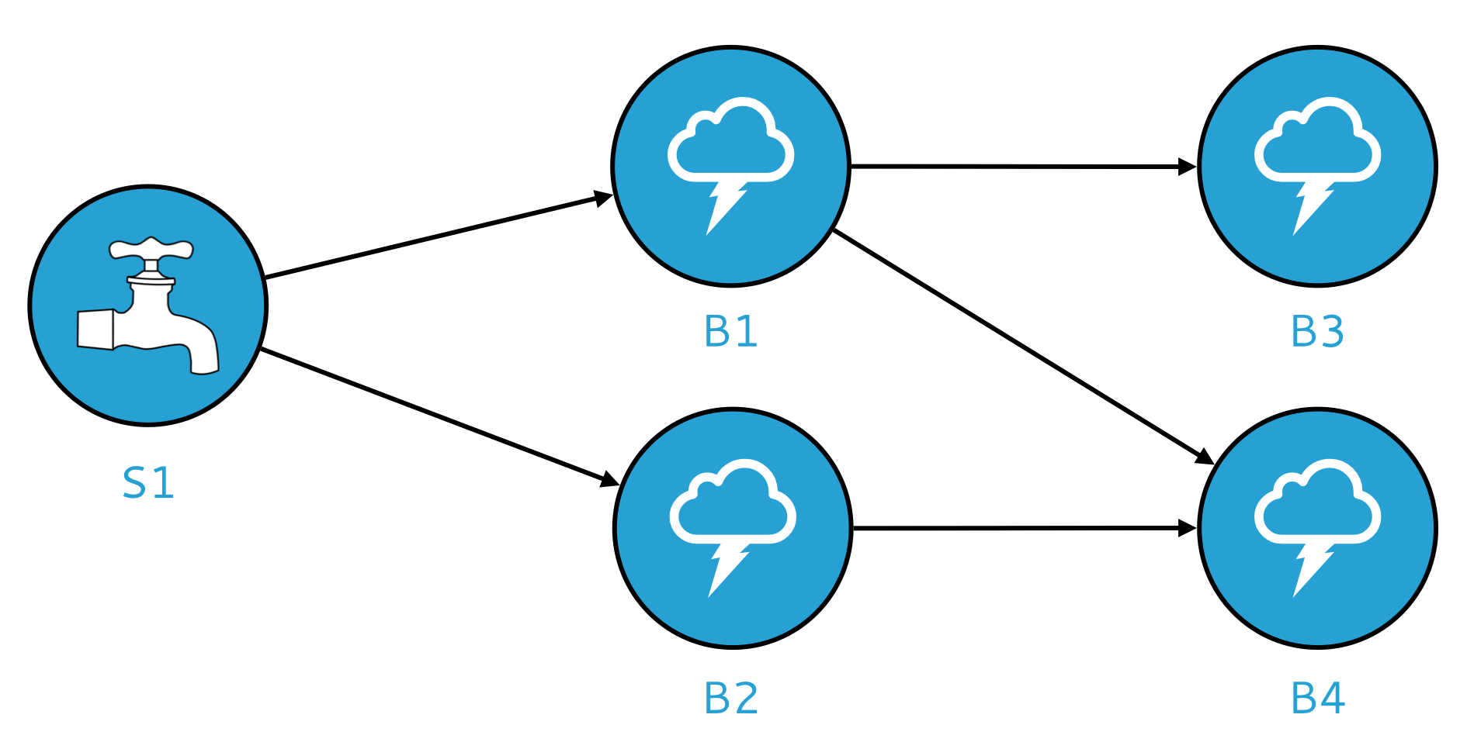
Spouts and Bolts: Logical Plan
Components
Tuples: data that flow through the topology
Spouts: responsible for emitting tuples
Bolts: responsible for processing tuples

Slide 31
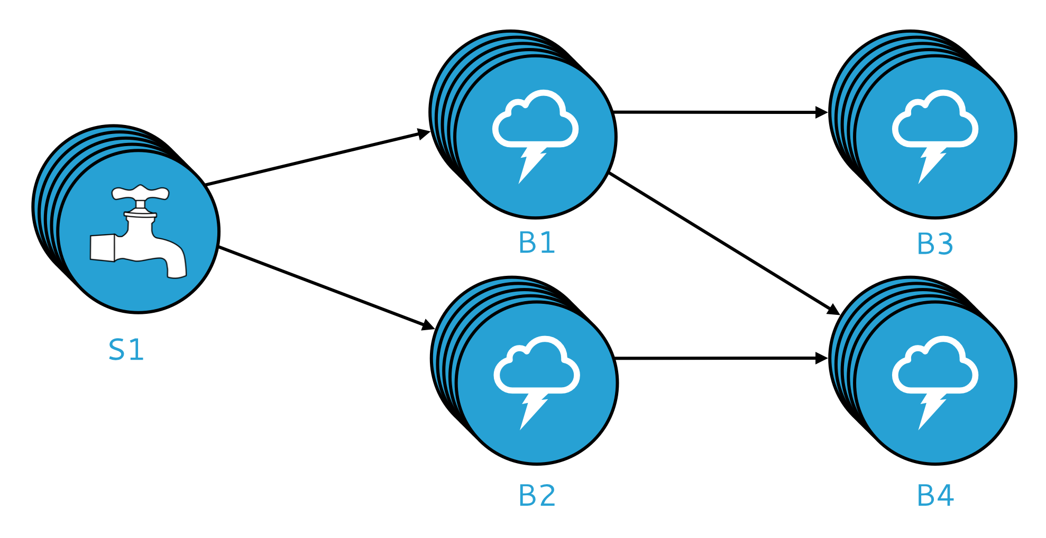
Spouts and Bolts: Physical Plan
Physical plan specifies execution details
Parallelism: how many instances of bolts and spouts to run
Placement of bolts/spouts on machines
…

Slide 32
Stream Groupings
Bolts are executed by multiple instances in parallel
User-specified as part of the topology
When a bolt emits a tuple, where should it go?
Answer: Grouping strategy
Shuffle grouping: randomly to different instances
Field grouping: based on a field in the tuple
Global grouping: to only a single instance
All grouping: to every instance

Slide 33
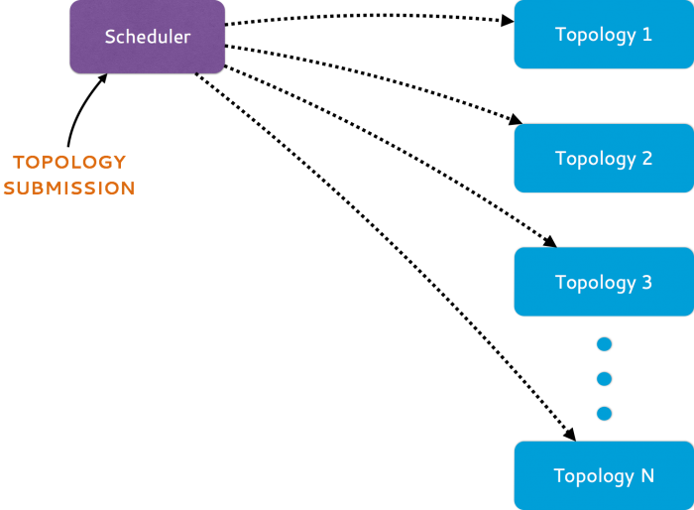
Heron Architecture
Source: https://blog.twitter.com/2015/flying-faster-with-twitter-heron

Slide 34
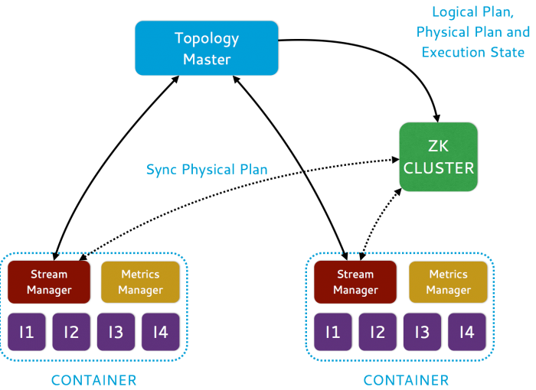
Heron Architecture
Source: https://blog.twitter.com/2015/flying-faster-with-twitter-heron

Slide 35
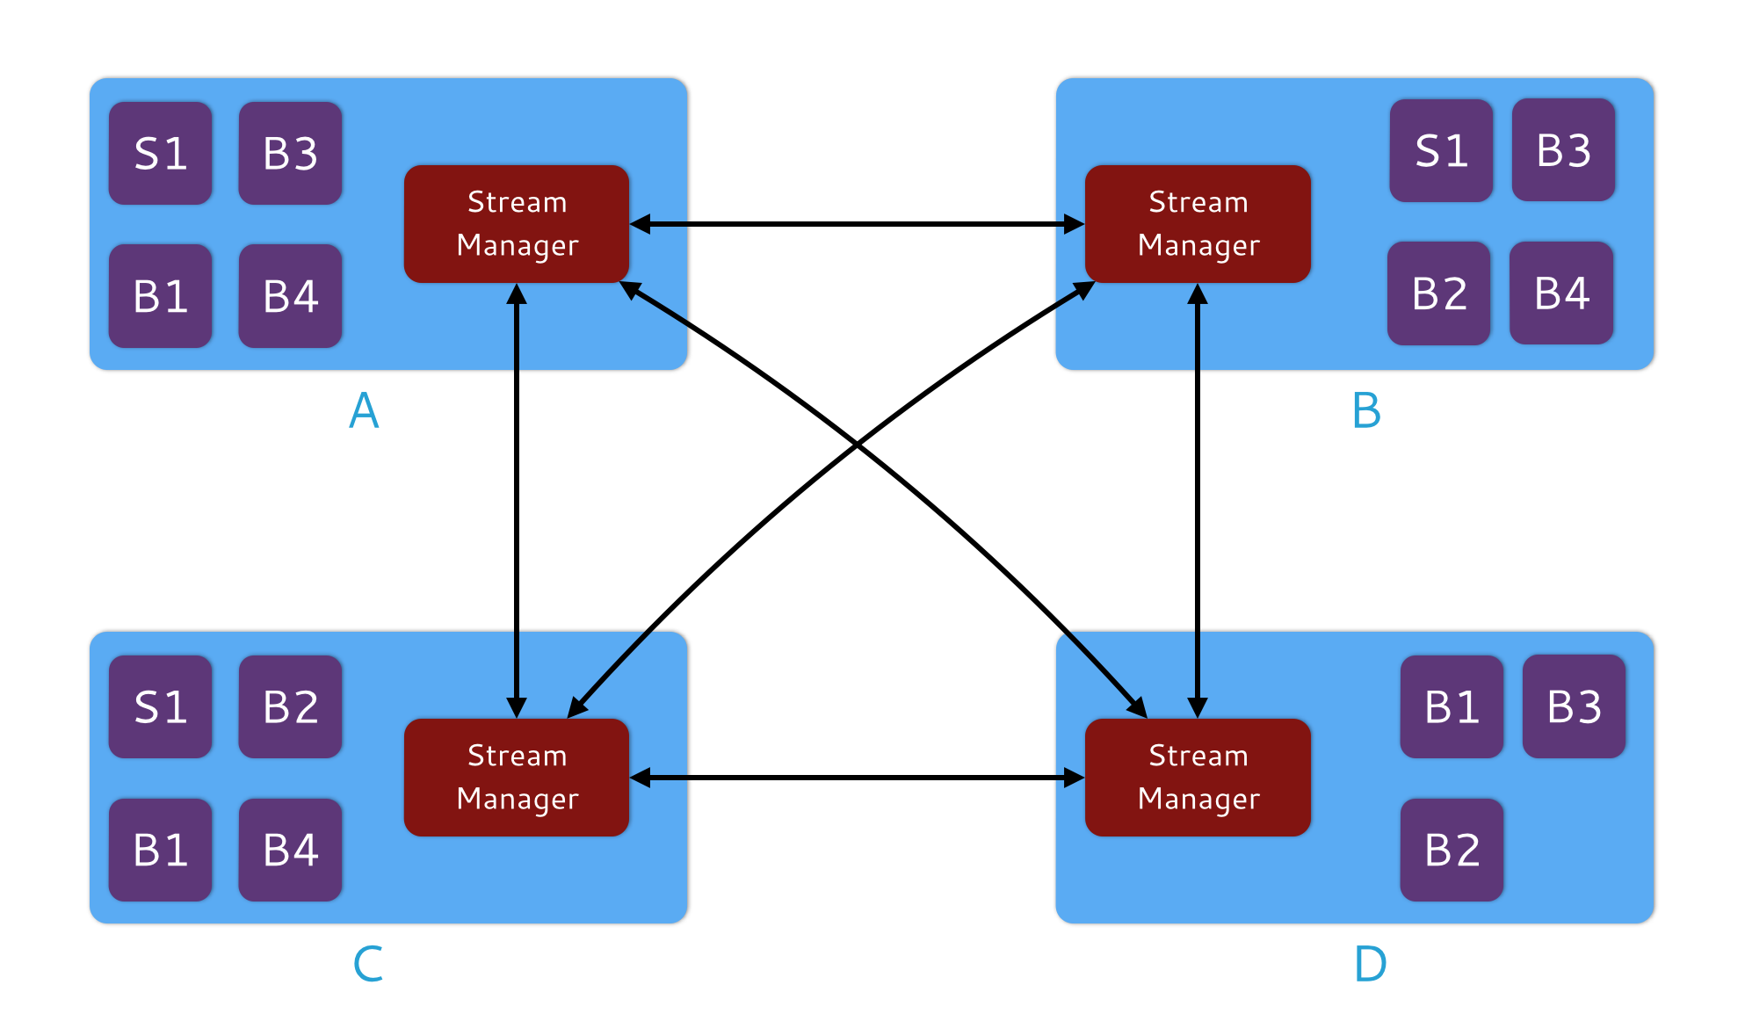
Heron Architecture
Stream Manager
Manages routing tuples between spouts and bolts
Responsible for applying backpressure

Slide 36
Some me some code!
TopologyBuilder builder = new TopologyBuilder();
builder.setSpout("word", new WordSpout(), parallelism);
builder.setBolt("consumer", new ConsumerBolt(), parallelism)
.fieldsGrouping("word", new Fields("word"));
Config conf = new Config();
// Set config here
// ...
StormSubmitter.submitTopology("my topology”, conf,
builder.createTopology());

Slide 37
Some me some code!
public static class WordSpout extends BaseRichSpout {
@Override
public void declareOutputFields(
OutputFieldsDeclarer outputFieldsDeclarer) {
outputFieldsDeclarer.declare(new Fields("word"));
}
@Override
public void nextTuple() {
// ...
collector.emit(word);
}
}

Slide 38
Some me some code!
public static class ConsumerBolt extends BaseRichBolt {
private OutputCollector collector;
private Map<String, Integer> countMap;
public void prepare(Map map, TopologyContext
topologyContext, OutputCollector outputCollector) {
collector = outputCollector;
countMap = new HashMap<String, Integer>();
}
@Override
public void execute(Tuple tuple) {
String key = tuple.getString(0);
if (countMap.get(key) == null) {
countMap.put(key, 1);
} else {
Integer val = countMap.get(key);
countMap.put(key, ++val);
}
}
}
What’s the issue?

Slide 39
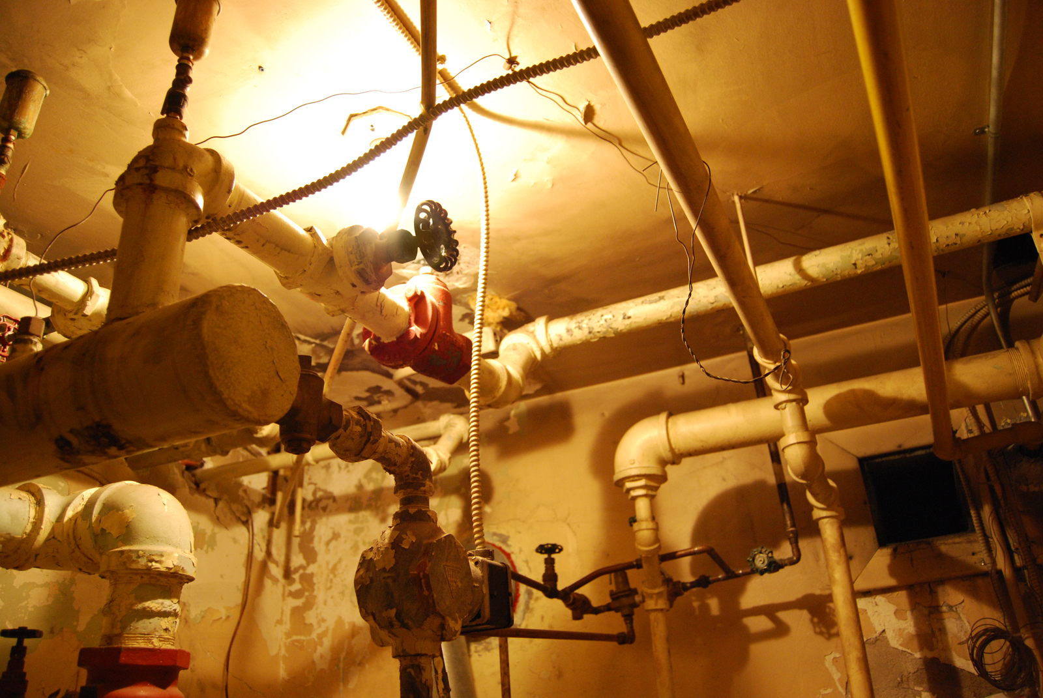
Source: Wikipedia (Plumbing)

Slide 40
Spark Streaming
Stream Processing Frameworks
Source: Wikipedia (River)

Slide 41

Hmm, I gotta get in on this streaming thing…
But I got all this batch processing framework that I gotta lug around.
I know: we’ll just chop the stream into little pieces, pretend each is an RDD, and we’re on our merry way!
Want real-time stream processing?
I got your back.
I’ve got the most intuitive implementation: a computation graph!

Slide 42
Spark Streaming: Discretized Streams
Run a streaming computation as a series
of very small, deterministic batch jobs
Chop up the stream into batches of X seconds
Process as RDDs!
Return results in batches
live data stream
Spark
Streaming
batches of X seconds
Spark
processed results
Typical batch window ~1s
Source: All following Spark Streaming slides by Tathagata Das

Slide 43
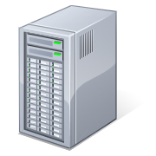
Example: Get hashtags from Twitter
val tweets = ssc.twitterStream(<Twitter username>, <Twitter password>)
DStream: a sequence of RDD representing a stream of data
Twitter Streaming API
batch @ t+1
batch @ t
batch @ t+2
tweets DStream
stored in memory as an RDD (immutable, distributed)

Slide 44
Example: Get hashtags from Twitter
val tweets = ssc.twitterStream(<Twitter username>, <Twitter password>)
val hashTags = tweets.flatMap (status => getTags(status))
new DStream
transformation: modify data in one Dstream to create another DStream
batch @ t
batch @ t+1
batch @ t+2
tweets DStream
flatMap
flatMap
flatMap
hashTags Dstream
[#cat, #dog, … ]
…
new RDDs created for every batch

Slide 45
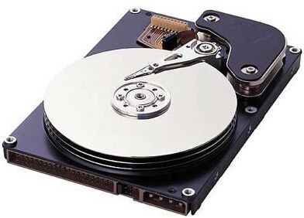
Example: Get hashtags from Twitter
val tweets = ssc.twitterStream(<Twitter username>, <Twitter password>)
val hashTags = tweets.flatMap (status => getTags(status))
hashTags.saveAsHadoopFiles("hdfs://...")
output operation: to push data to external storage
batch @ t
batch @ t+1
batch @ t+2
tweets DStream
flatMap
flatMap
flatMap
hashTags DStream
save
save
save
every batch saved to HDFS

Slide 46
Fault Tolerance
Bottom line: they’re just RDDs!

Slide 47
Fault Tolerance
Bottom line: they’re just RDDs!
tweets
RDD
input data replicated
in memory
flatMap
hashTags
RDD
lost partitions recomputed on other workers

Slide 48
Key Concepts
DStream – sequence of RDDs representing a stream of data
Twitter, HDFS, Kafka, Flume, ZeroMQ, Akka Actor, TCP sockets
Transformations – modify data from on DStream to another
Standard RDD operations – map, countByValue, reduce, join, …
Stateful operations – window, countByValueAndWindow, …
Output Operations – send data to external entity
saveAsHadoopFiles – saves to HDFS
foreach – do anything with each batch of results

Slide 49
Example: Count the hashtags
val tweets = ssc.twitterStream(<Twitter username>, <Twitter password>)
val hashTags = tweets.flatMap (status => getTags(status))
val tagCounts = hashTags.countByValue()
batch @ t
batch @ t+1
batch @ t+2
tweets
flatMap
flatMap
flatMap
hashTags
map
map
…
map
tagCounts
[(#cat, 10), (#dog, 25), ... ]
reduceByKey
reduceByKey
reduceByKey

Slide 50
Example: Count the hashtags over last 10 mins
val tweets = ssc.twitterStream(<Twitter username>, <Twitter password>)
val hashTags = tweets.flatMap (status => getTags(status))
val tagCounts = hashTags.window(Minutes(10), Seconds(1)).countByValue()
sliding window operation
window length
sliding interval

Slide 51
Example: Count the hashtags over last 10 mins
val tagCounts = hashTags.window(Minutes(10), Seconds(1)).countByValue()
t-1
t
t+1
t+2
t+3
hashTags
sliding window
countByValue
count over all the data in the window
tagCounts

Slide 52
Smart window-based countByValue
val tagCounts = hashtags.countByValueAndWindow(Minutes(10), Seconds(1))
t-1
t
t+1
t+2
t+3
hashTags
countByValue
add the counts from the new batch in the window
subtract the counts from batch before the window
–
+
tagCounts
+
?

Slide 53
Smart window-based reduce
Incremental counting generalizes to many reduce operations
Need a function to “inverse reduce” (“subtract” for counting)
val tagCounts = hashtags
.countByValueAndWindow(Minutes(10), Seconds(1))
val tagCounts = hashtags
.reduceByKeyAndWindow(_ + _, _ - _, Minutes(10), Seconds(1))

Slide 54
What’s the problem?
event time
vs.
processing time

Slide 55
Apache Beam
Stream Processing Frameworks
Source: Wikipedia (River)

Slide 56
Apache Beam
2013: Google publishes paper about MillWheel
2015: Google releases Cloud Dataflow
2016: Google donates API and SDK to Apache to become Apache Beam

Slide 57
Programming Model
Core Concepts
Pipeline: a data processing task
PCollection: a distributed dataset that a pipeline operates on
Transform: a data processing operation
Source: for reading data
Sink: for writing data
Processing semantics: exactly once

Slide 58
Looks a lot like Spark!
Pipeline p = Pipeline.create(options);
p.apply(TextIO.Read.from("gs://your/input/"))
.apply(FlatMapElements.via((String word) ->
Arrays.asList(word.split("[^a-zA-Z']+"))))
.apply(Filter.by((String word) -> !word.isEmpty()))
.apply(Count.perElement())
.apply(MapElements.via((KV<String, Long> wordCount) ->
wordCount.getKey() + ": " + wordCount.getValue()))
.apply(TextIO.Write.to("gs://your/output/"));

Slide 59
The Beam Model
What results are computed?
Where in event time are the results computed?
When in processing time are the results materialized?
How do refinements of results relate?

Slide 60
Event Time vs. Processing Time
What’s the distinction?
Watermark: System’s notion when all data in a window is expected to arrive
Where in event time are the results computed?
When in processing time are the results materialized?
How do refinements of results relate?
Trigger: a mechanism for declaring when output of a window should be materialized
Default trigger “fires” at watermark
Late and early firings: multiple “panes” per window

Slide 61
Event Time vs. Processing Time
What’s the distinction?
Watermark: System’s notion when all data in a window is expected to arrive
Where in event time are the results computed?
When in processing time are the results materialized?
How do refinements of results relate?
How do multiple “firings” of a window (i.e., multiple “panes”) relate?
Options: Discarding, Accumulating, Accumulating & retracting

Slide 62
Word Count
Pipeline p = Pipeline.create(options);
p.apply(TextIO.Read.from("gs://your/input/"))
.apply(FlatMapElements.via((String word) ->
Arrays.asList(word.split("[^a-zA-Z']+"))))
.apply(Filter.by((String word) -> !word.isEmpty()))
.apply(Count.perElement())
.apply(MapElements.via((KV<String, Long> wordCount) ->
wordCount.getKey() + ": " + wordCount.getValue()))
.apply(TextIO.Write.to("gs://your/output/"));

Slide 63
Word Count
With windowing…
Pipeline p = Pipeline.create(options);
p.apply(KafkaIO.read("tweets")
.withTimestampFn(new TweetTimestampFunction())
.withWatermarkFn(kv ->
Instant.now().minus(Duration.standardMinutes(2))))
.apply(Window.into(FixedWindows.of(Duration.standardMinutes(2)))
.triggering(AtWatermark()
.withEarlyFirings(AtPeriod(Duration.standardMinutes(1)))
.withLateFirings(AtCount(1)))
.accumulatingAndRetractingFiredPanes())
.apply(FlatMapElements.via((String word) ->
Arrays.asList(word.split("[^a-zA-Z']+"))))
.apply(Filter.by((String word) -> !word.isEmpty()))
.apply(Count.perElement())
.apply(KafkaIO.write("counts"))
Where in event time?
When in processing time?
How do refines relate?

Slide 64

Questions?
Source: Wikipedia (Japanese rock garden)

